Slide 1
BANK 2 THE FUTURE
ALEXANDER HILTON
ANTONINO MAGNANO
FENGNAN ZHAO
WAYNE LEONG
KARTHICKPRABU RAJAMANI

Slide 2


Problem Statement
Order
Management
Platform
Customer
Dealer

Slide 3

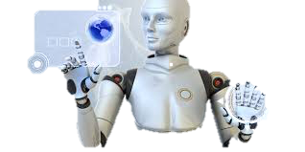
AI

Slide 4
AI & Cognitive Services
Speech recognition
Speech to Text
Language understanding (LUIS) with Machine Learning
Intents, entities & actions
Bots

Slide 5
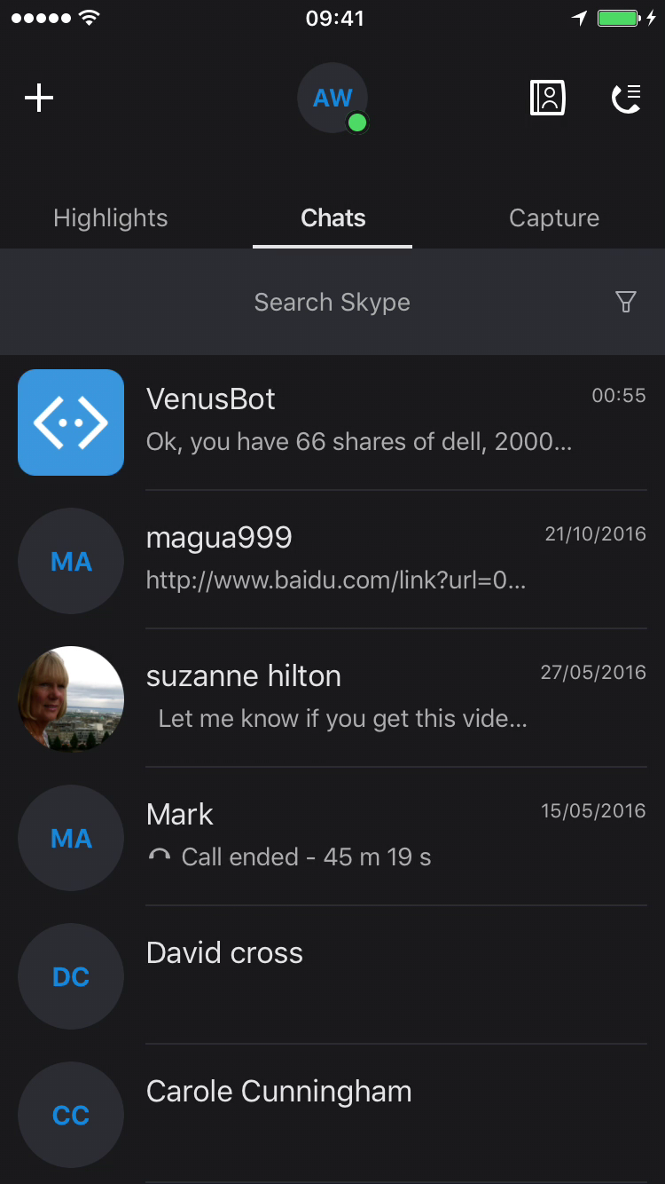
Why Bots
Language understanding
Conversational UI and Integration
with LUIS
Intent understanding – Dialog Flow
Good fit for OMS domain
Channels
Integration with Skype, Cortana…

Slide 6
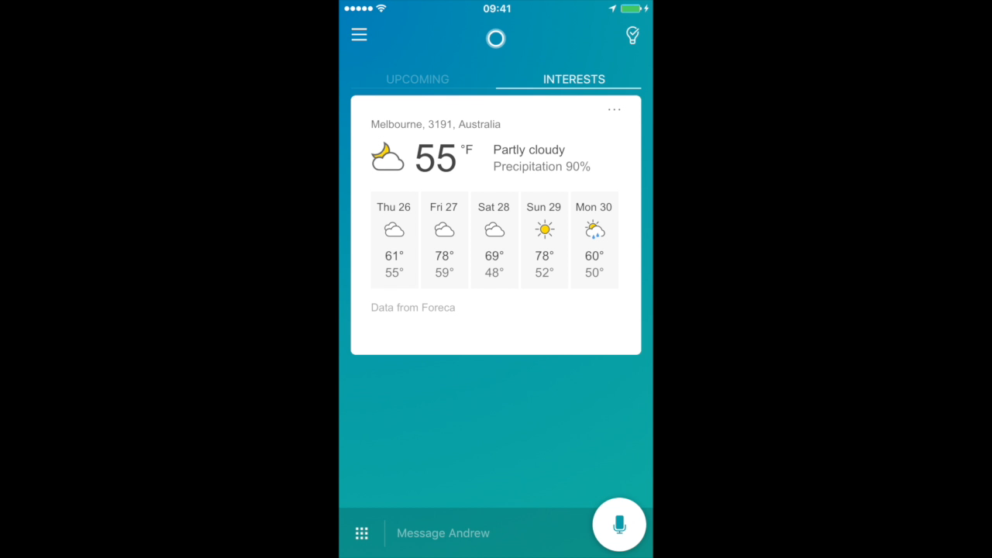

Slide 7
AI is the new UI

Slide 8

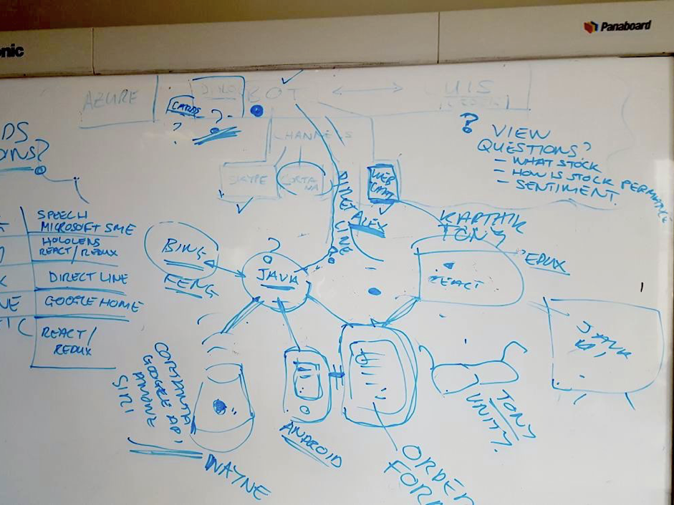

AI is the new UI… Great Scott!!

Slide 9








Slide 10
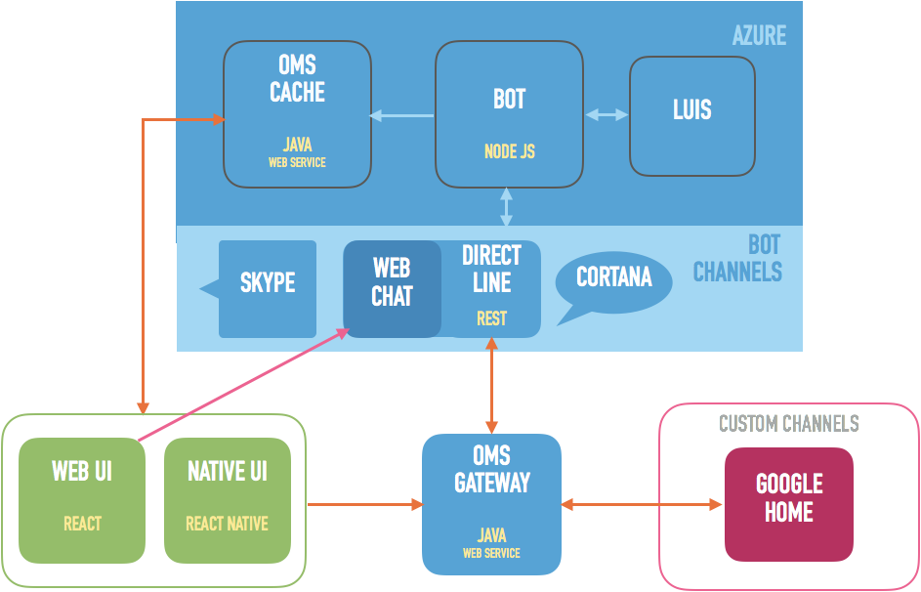

Slide 11
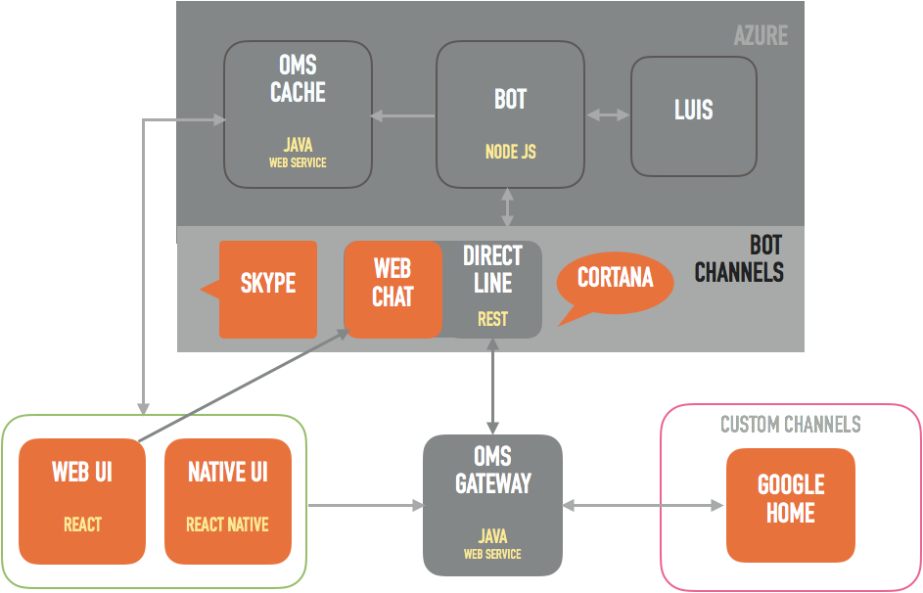

Slide 12
DEMO

Slide 13
Learning
AI
Language understanding, training
Collaboration
GitHub
Technology
Node JS / React / Java Web Services + Swagger / Rest
Cloud
Azure – deployment, setup (logging!)
Bot Channel integration

